Slide 1


Java Exception Handling
Sydubabu Vasantha
June 15, 2017

Slide 2
Agenda
Overview of Exception
Overview of Error
Hierarchy of Exception classes
Types of Exceptions
Catching Exceptions
Custom Exceptions

Slide 3
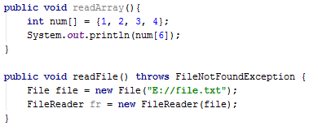
Overview Of Exception
An exception is a problem that arises during the execution of a program. When an Exception occurs the normal flow of the program is disrupted and the program/Application terminates abnormally, which is not recommended, therefore, these exceptions are to be handled.
An exception can occur for many different reasons. Following are some scenarios where an exception occurs.
A file that needs to be opened cannot be found.
A user has entered an invalid data.

Slide 4
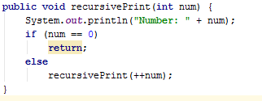
Overview of Error
These are not exceptions at all, but problems that arise beyond the control of the user or the programmer.
Errors are typically ignored in your code because you can rarely do anything about an error. For example, if a stack overflow occurs, an error will arise.
They are also ignored at the time of compilation.

Slide 5
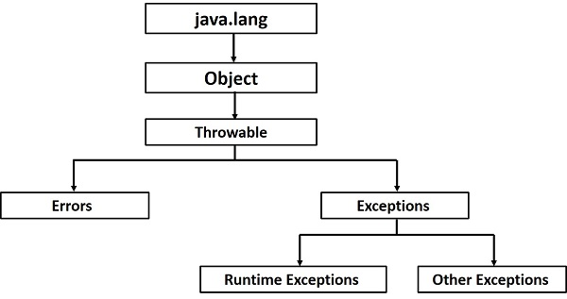
Hierarchy of Exception Classes
Throwable: Superclass of all errors and exceptions in the Java language.
Only objects that are instances of this class (or one of its subclasses) are thrown by the Java Virtual Machine or can be thrown by the Java throw statement.
Similarly, only this class or one of its subclasses can be the argument type in a catch clause.
Exception: The class Exception and its subclasses are a form of Throwable that indicates conditions that a reasonable application might want to catch.
Error:An Error is a subclass of Throwable that indicates serious problems that a reasonable application should not try to catch.

Slide 6
Types of Exceptions
There are mainly two types of exceptions: checked and unchecked where error is considered as unchecked exception. The sun microsystem says there are three types of exceptions
Checked exceptions
Unchecked exceptions
Error

Slide 7
Checked Exceptions
A checked exception is an exception that occurs at the compile time, these are also called as compile time exceptions. These exceptions cannot simply be ignored at the time of compilation, the programmer should take care of (handle) these exceptions.
IOException
SQLException
DataAccessException

Slide 8
Unchecked Exceptions
An unchecked exception is an exception that occurs at the time of execution. These are also called as Runtime Exceptions. These include programming bugs, such as logic errors or improper use of an API. Runtime exceptions are ignored at the time of compilation.
NullPointerException
ArithmeticException
ArrayIndexOutOfBoundsException

Slide 9
Catching Exceptions
There are 5 keywords used in java exception handling.
try
catch
finally
throw
throws

Slide 10
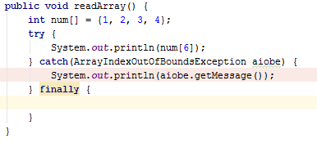
Try-catch block
A method catches an exception using a combination of the try and catch keywords.
A try/catch block is placed around the code that might generate an exception.
Code within a try/catch block is referred to as protected code.
The code which is prone to exceptions is placed in the try block.
Every try block should be immediately followed either by a catch block or finally block.

Slide 11
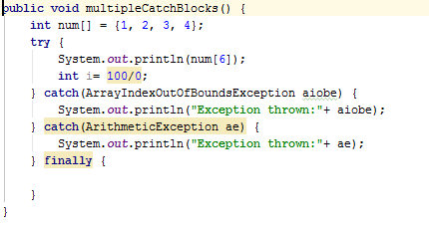
Multiple Catch Blocks
A try block can be followed by multiple catch blocks.
We can have any number of catch blocks after a single try.
If the data type of the exception thrown matches ExceptionType1, it gets caught there. If not, the exception passes down to the second catch statement.
This Continues until the exception either is caught or falls through all catches, in which case the current method stops execution and the exception is thrown down to the previous method on the call stack.

Slide 12
Finally block
The finally block follows a try block or a catch block. A finally block of code always executes, irrespective of occurrence of an Exception.
Using a finally block allows you to run any cleanup-type statements that you want to execute, no matter what happens in the protected code.

Slide 13

Throws/throw
If a method does not handle a checked exception, the method must declare it using the throws keyword. The throws keyword appears at the end of a method's signature.
You can throw an exception, either a newly instantiated one or an exception that you just caught, by using the throw keyword.
A method can declare that it throws more than one exception, in which case the exceptions are declared in a list separated by commas.

Slide 14
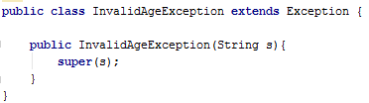
Custom Exceptions
All exceptions must be a child of Throwable.
If you want to write a checked exception that is automatically enforced by the Handle or Declare Rule, you need to extend the Exception class.
If you want to write a runtime exception, you need to extend the RuntimeException class.

Slide 15
THANK YOU

